Slide 1
Notes:
Thank you again for carving time out of your busy schedules
You are all critical to the future of Scouting and we're honored to play a role in partnering with you to be helpful and supportive
Before I hand it over to Mike, this is a day to take about where we’re at, where we're going, and how we can best serve you
This is meant to be a time for you to talk and share so please chime in at any time

Slide 2
2024 Top Sellers
Scout Fundraising
Rank | Scout | Unit | District | Total Sales $
1 | Preston E. | Pack 7721 | Crossroads | $18,520
2 | Jacob S. | Pack 7721 | Crossroads | $10,668
3 | Teddy A. | Pack 7721 | Crossroads | $5,558
4 | Jace M. | Pack 7721 | Crossroads | $4,714
5 | RJ M. | Pack 7721 | Crossroads | $4,511
6 | David L. | Pack 1001 | Osprey | $4,100
7 | Jacob M. | Pack 2022 | Pinelands | $4,076
8 | Erik M. | Pack 2022 | Pinelands | $4,049
9 | Josef F. | Pack 7721 | Crossroads | $4,003
10 | Kaylee K. | Pack 7721 | Crossroads | $3,896
Rank | Unit | District | Total Sales $
1 | Pack 7721 | Crossroads | $130,648
2 | Pack 4176 | Pine Hill | $21,997
3 | Pack 2022 | Pinelands | $19,159
4 | Pack 1001 | Osprey | $17,432
5 | Pack 7161 | Crossroads | $16,942
6 | Pack 4015 | Pine Hill | $8,371
7 | Troop 4076 | Pine Hill | $7,616
8 | Pack 1025 | Osprey | $6,939
9 | Pack 4059 | Pinelands | $6,822
10 | Pack 4234 | Pinelands | $5,570

Slide 3
Ideal Year of Scouting
Scout Fundraising
Plan Program
List activities & adventures
Hold a brainstorming session with families
Add a new trip or campout for excitement.
Budget
Use TE budget tool to assign costs and expenses.
Add in camp, registration fees, advancements & Unit dues.
Calendar
Provide a monthly calendar of activities so families are aware of the fun.
Set Goals
Total Program Costs ÷ Unit Commission = Unit Sales Goal.
Divide Unit goal by # of Scouts to get Scout goals.
Raise the Money
Commit to achieving the Unit’s goal with one fundraiser.
Less time fundraising = more time Scouting!
Enjoy the Year!
Notes:
Include family planner (from IYOS scope sheet)

Slide 4
Scout Fundraising
Notes:
Include family planner (from IYOS scope sheet)

Slide 5
Ways to Sell
Scout Fundraising
Storefronts
Setup tables at high foot traffic locations.
Scouts sell to customers coming in and out of stores.
Best Practice: One Scout and their parent per shift.
Wagon
Sell door-to-door
Best Practice: Bring product with you to avoid second trip to deliver.
Scouts can record undelivered orders in App.
Online
Sell virtually to family and friends by sharing your online fundraising page via social, email & text.
Product ships to the customer.
Safest way to sell!

Slide 6
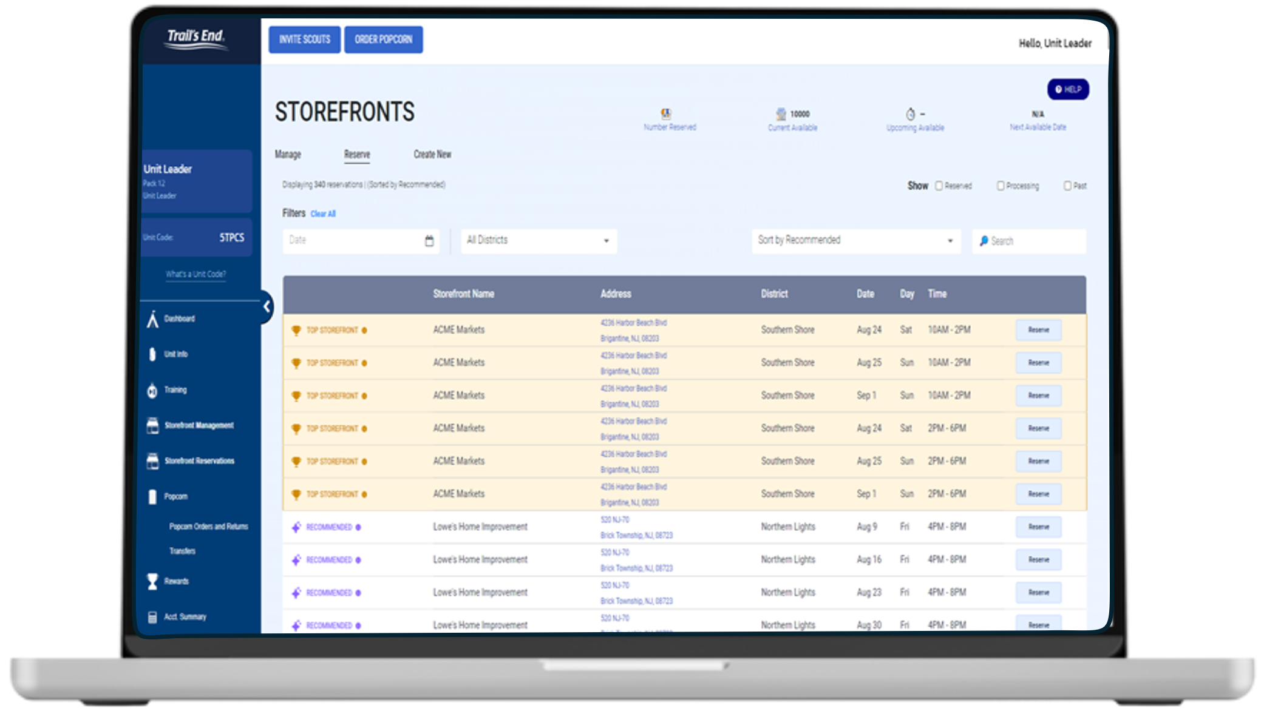
Trail’s End technology
Unit portal
Leaders manage entire sale in one place
Invite Scouts to register and manage Scout roster
​Easily set Unit and Scout goals
Order popcorn
Real time reporting of sales and inventory
Unit to unit transfers; no Council assistance needed
Schedule and manage storefront sites and shifts
Notes:
The app isn’t just for selling, Scouts can earn rewards and see their progress in the app as they sell
And We’re thrilled to offer more gift card options for 2025.
Scouts can choose giftcards for Walmart, Target, Cabela’s, REI, or a Mastercard gift card. Amazon is still available too.
With all these choices, Scouts can even split their rewards between more than one gift card, choosing the options that really excite them
It’s easy to claim their rewards and Scouts are guided through the entire process

Slide 7
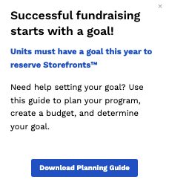
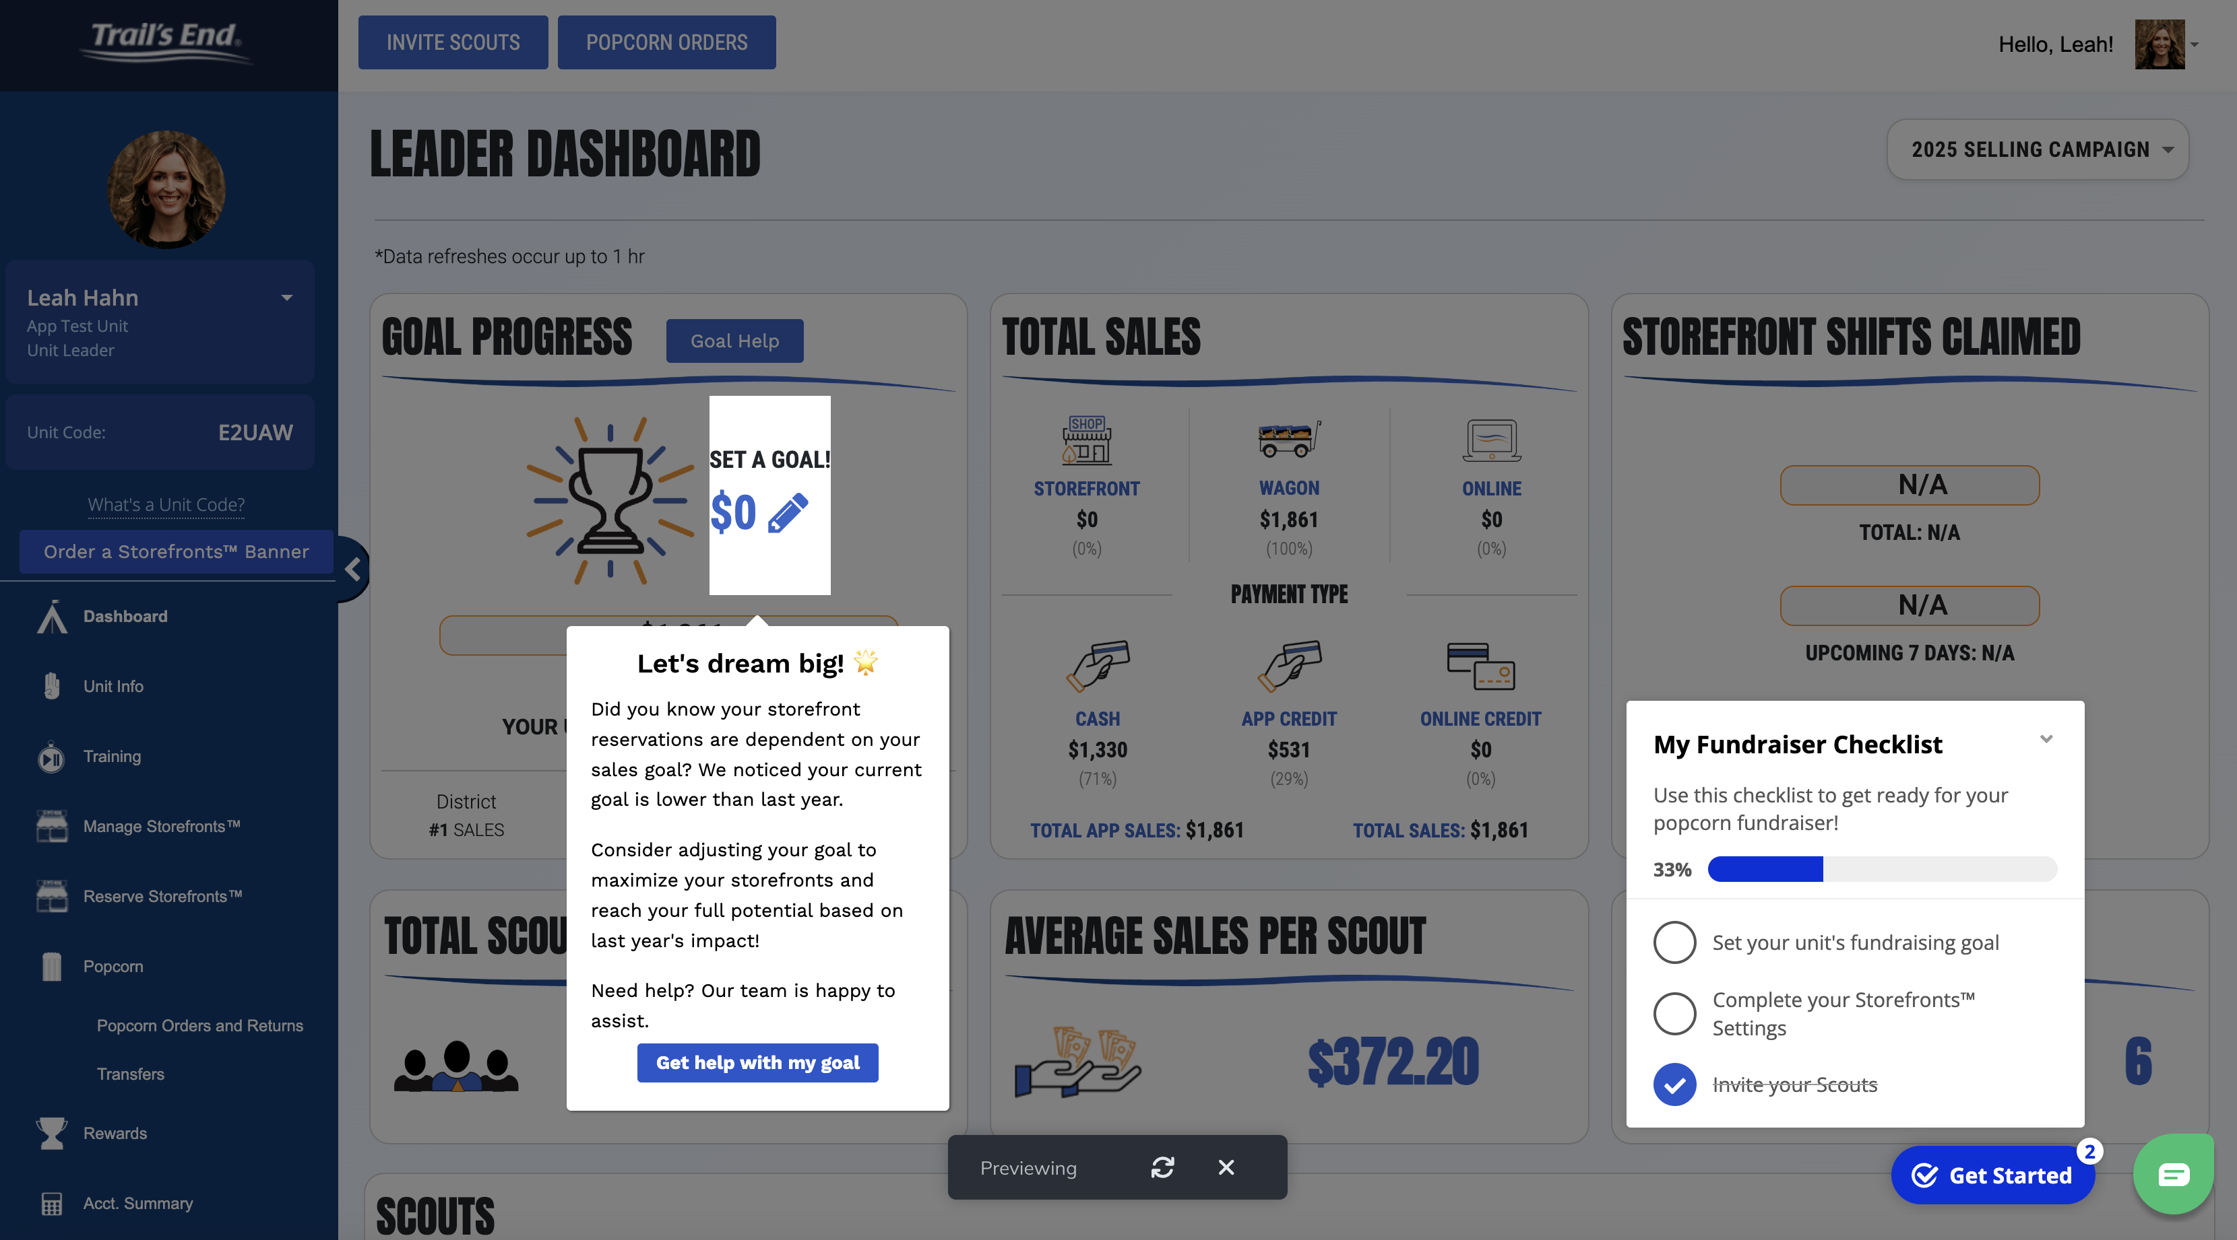
IN-APP GUIDES
232 users
Goal avg. $19,196
570+ completed
1700 units with a goal
Notes:
Was over $4000 below their last years sales, now increased goal by $1500 over last year’s sales

Slide 8
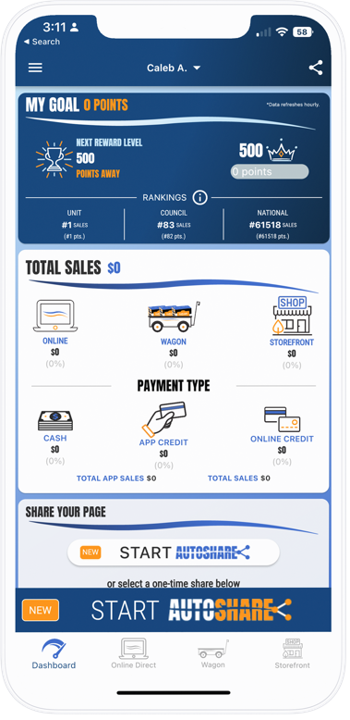
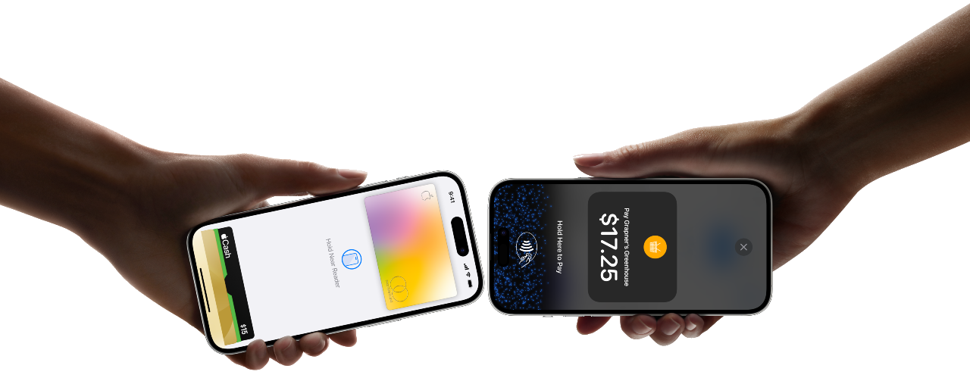
Trail’s End technology
Scout app
Point of Sale System
Saves time and easy to use
Google Play & Apple App Store​
Tracks real-time Scout sales/inventory
Manages storefront shifts
Accepts credit cards (85%+) and cash
All CC Fees paid by TE​
Tap to pay directly through phone
Notes:
The app isn’t just for selling, Scouts can earn rewards and see their progress in the app as they sell
And We’re thrilled to offer more gift card options for 2025.
Scouts can choose giftcards for Walmart, Target, Cabela’s, REI, or a Mastercard gift card. Amazon is still available too.
With all these choices, Scouts can even split their rewards between more than one gift card, choosing the options that really excite them
It’s easy to claim their rewards and Scouts are guided through the entire process

Slide 9
Trail’s End technology
Tap to pay demo
Notes:
The

Slide 10
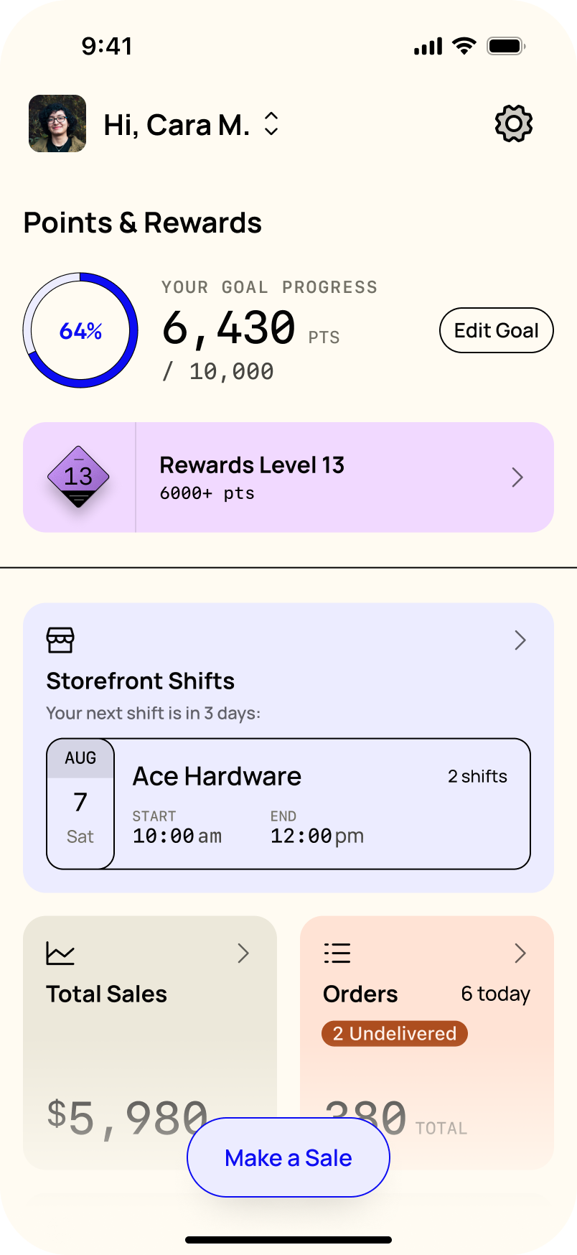
Trail’s End App
APP REFRESH
Single screen for all key actions:
Make a sale
Goal and rewards
Cash to Credit
Storefronts
Sales data
Orders
Online sales
Training

Slide 11
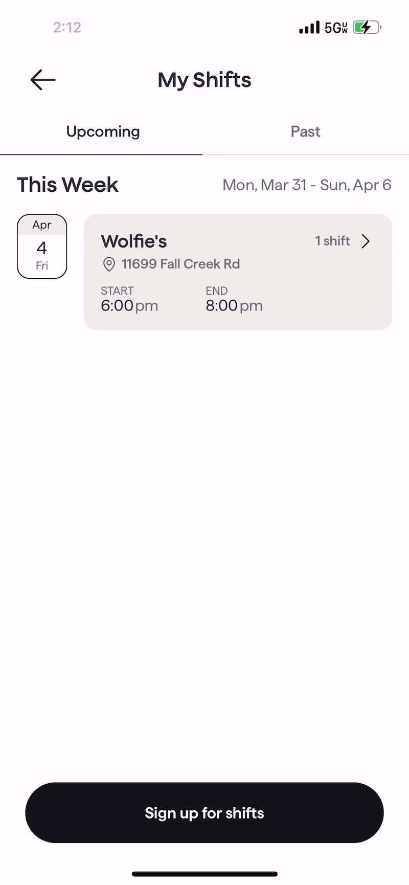
Notes:
The app isn’t just for selling, Scouts can earn rewards and see their progress in the app as they sell
And We’re thrilled to offer more gift card options for 2025.
Scouts can choose giftcards for Walmart, Target, Cabela’s, REI, or a Mastercard gift card. Amazon is still available too.
With all these choices, Scouts can even split their rewards between more than one gift card, choosing the options that really excite them
It’s easy to claim their rewards and Scouts are guided through the entire process

Slide 12
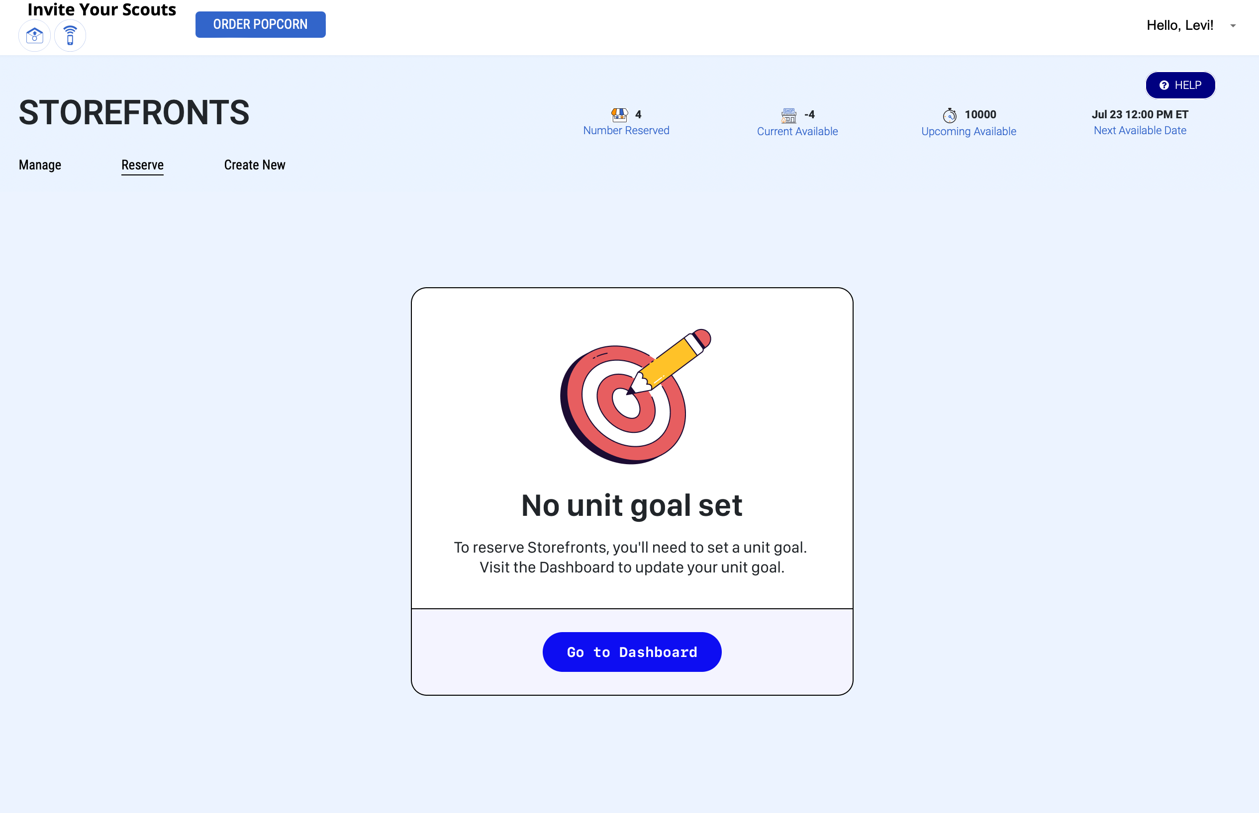
STOREFRONT EFFICIENCY
Updated reservation time – 8 pm (ET)
Goal required to reserve storefronts
Guidance on storefront hours needed to reach goal
Auto-release on Thursdays at 8 pm (ET) for Fri - Sun reservations
38% of weekend hours were claimed in 2024 and not used by Scouts

Slide 13
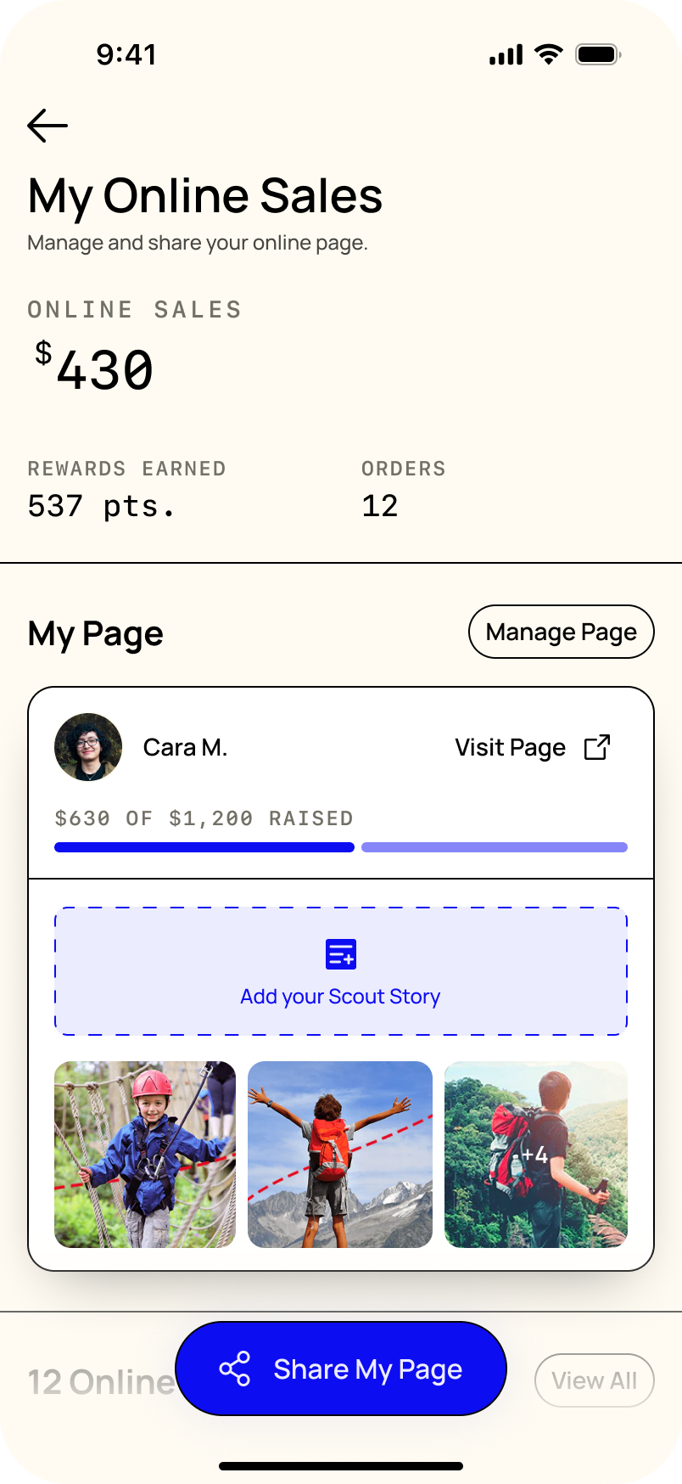
Trail’s End App
ONLINE SALES
Share is the primary action for Scouts
Past customers
Text
Email
Social
Scouts are guided to personalize their page with new empty states to help them get started

Slide 14
TRAIL’S END ONLINE
Redesigned Scout pages that:
Emphasize the Scout and their story
Allow consumers to share the Scout’s pages with their network

Slide 15
AMAZON
TARGET
WALMART
PREPAID MASTERCARD
DICK’S SPORTING GOODS
NINTENDO
GAMESTOP
BASS PRO SHOPS
CABELA’S
APPLE
LEGO
XBOX
PLAYSTATION
Trail’s End App
Scout Rewards
Balance: 100.00
Scouts claim their rewards from the app
15 gift card options
Scouts can split their rewards across multiple gift cards
No approving, receiving, distributing, or replacing prizes.
Uncapped levels to incentivize top sellers.
Heroes and helpers bonus points! +.5 pts!
Notes:
The app isn’t just for selling, Scouts can earn rewards and see their progress in the app as they sell
And We’re thrilled to offer more gift card options for 2025.
Scouts can choose giftcards for Walmart, Target, Cabela’s, REI, or a Mastercard gift card. Amazon is still available too.
With all these choices, Scouts can even split their rewards between more than one gift card, choosing the options that really excite them
It’s easy to claim their rewards and Scouts are guided through the entire process

Slide 16
Header
Scout Pitch
Scout Fundraising
Hello my name is ________ !
I am earning my way to summer camp, with a $20 donation you can pick any bag on the table and help me earn my archery, canoeing, and first aid merit badge!
NEVER, NEVER, NEVER ask customers to buy popcorn. It’s to support You!
Even if the customer says no, always say, “Thank you” and “Have a good day.”
Notes:
Parent Pay Now & Heroes & Helpers

Slide 17
Header
PRODUCTS and Pricing
Scout Fundraising
REMEMBER – YOU ARE NOT SELLING POPCORN. ANYONE CAN GO INTO A GROCERY STORE AND BUY A BAG!
Change your mindset to “with a $20 donation you will be helping me attend *insert adventure like Jamboree / specific summer camp!” and pick anything from the table!
NEVER, NEVER, NEVER ask customers to buy popcorn. It’s to support You!
Even if the customer says no, always say, “Thank you” and “Have a good day.”
Notes:
Parent Pay Now & Heroes & Helpers

Slide 18
Header
$20 on almost all items?!
Scout Fundraising
One price – simplifies the fundraiser.
Inventory management
Mistakes with selling the wrong bag
Trail’s End tested this mix last year!
$11 an hour increase
8% more Yeses
Scouts understand its not about the product its about ME and my Unit.
NEVER, NEVER, NEVER ask customers to buy popcorn. It’s to support You!
Even if the customer says no, always say, “Thank you” and “Have a good day.”
Notes:
Parent Pay Now & Heroes & Helpers

Slide 19
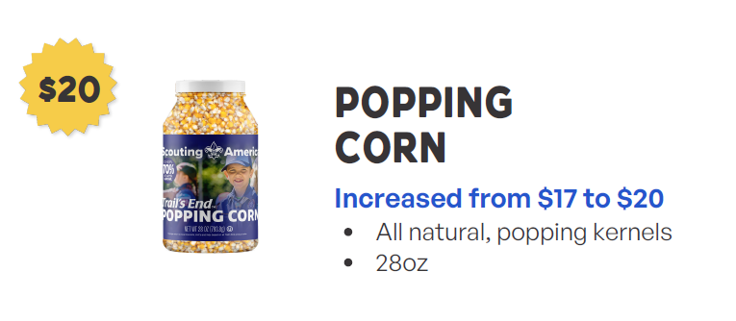
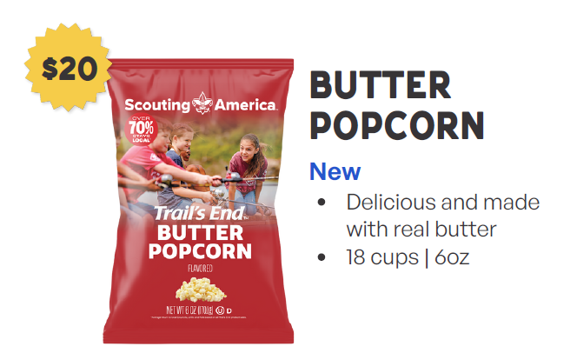
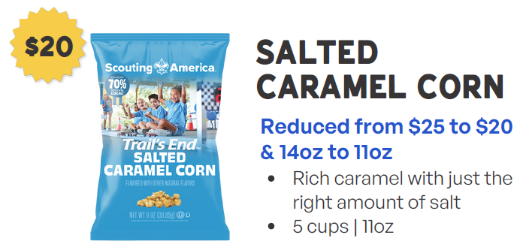
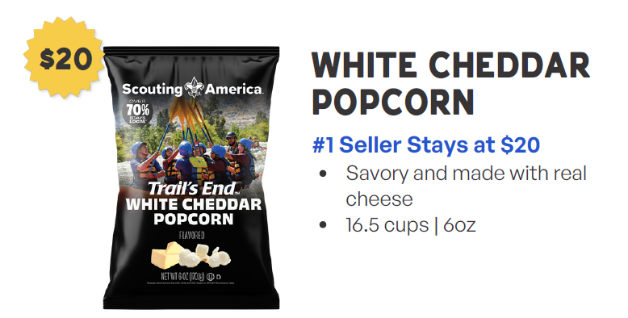
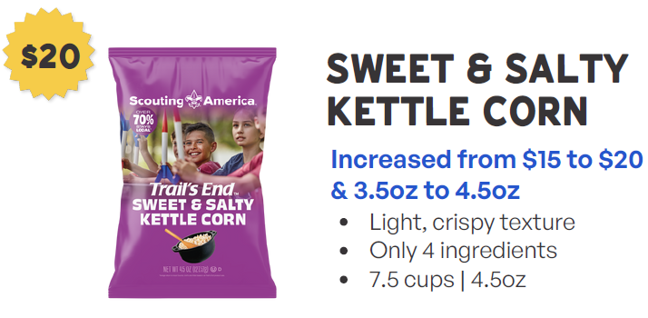

Slide 20
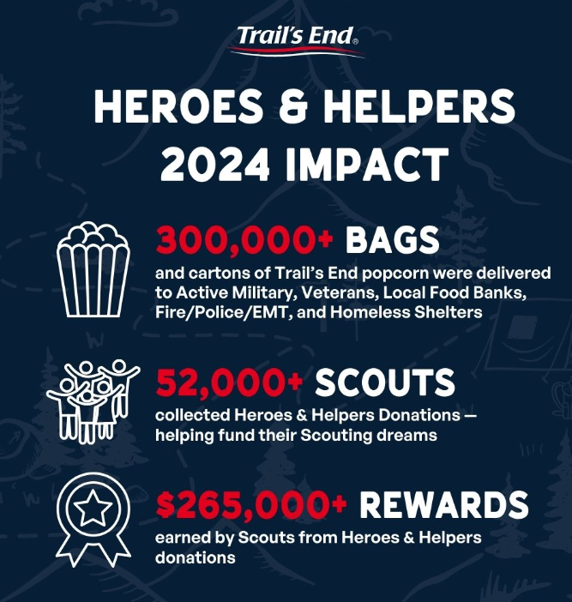
Any $ donation should be turned into the heroes and helpers program!
Scouts earn an additional 0.5 points per donation!
$1 credit card donation = 1.75 pts!
$1 cash donation = 1.5 pts!

Slide 21
Header
Council Sale Details
Scout Fundraising
Dates
Kickoffs – 6/21 and 6/28
Ordering Portal Opens – 6/28
Initial Order Due – 8/3
Initial Order Distribution/Pick Up – 8/15
Ordering Portal Opens for Final Order – 10/20
Final Product Due in TE System – 11/2
Final Product Distribution/Pick Up – 11/14
Popcorn Payment is Due – 12/5
Bonus Commission
Between $7,500-$19,999 – 1%
Between $20,000-$29,999 – 2%
Between $30,000-$39,999 – 3%
Between $40,000-$49,999 – 4%
Sales over $50,000 – 5%
Total Commission Possible – 40%
Commission
Base 33% (Storefront & Wagon)
2 % - Attend Kickoff
Online 35%

Slide 22
Header
Council Sale Details
Scout Fundraising
GSC Incentives
Top Selling Scout will win $250 towards a week of GSC Summer Camp!
Top 10 Scouts and Top 10 Units will be displayed throughout the Sale on our GSC Leaderboard.
Spin to Event in Jan 2026
All scouts who sell over $1,250 will be invited to a special event with fun, food, and prizes
Blitz Weekends
Blitz weekend 1 8/22-8/23
Blitz weekend 2 – 9/20-9/21
Blitz weekend 3 – 10/11-10/12
Blitz Weekends
Blitz weekend – For each weekend, each scout who participates in any part of the Popcorn Sale gets their name entered into a drawing
For each weekend:
One winner from each District - $50 Amazon gift card
One grand prize Council winner - $100 Amazon gift card

Slide 23
Header
Council Sale Details
Scout Fundraising
Popcorn Partner – Morey’s Piers and Water Parks
$100,000 in Total Sales
- Complimentary waterpark pass for all youth in the unit.
$25,000 in Total Sales
- Complimentary waterpark pass for all youth in units, with the purchase of an adult ticket.
$15,000 in Total Sales
- Complimentary pass for the Spring Beach Jam for all youth in units, with the purchase of an adult ticket.

Slide 24
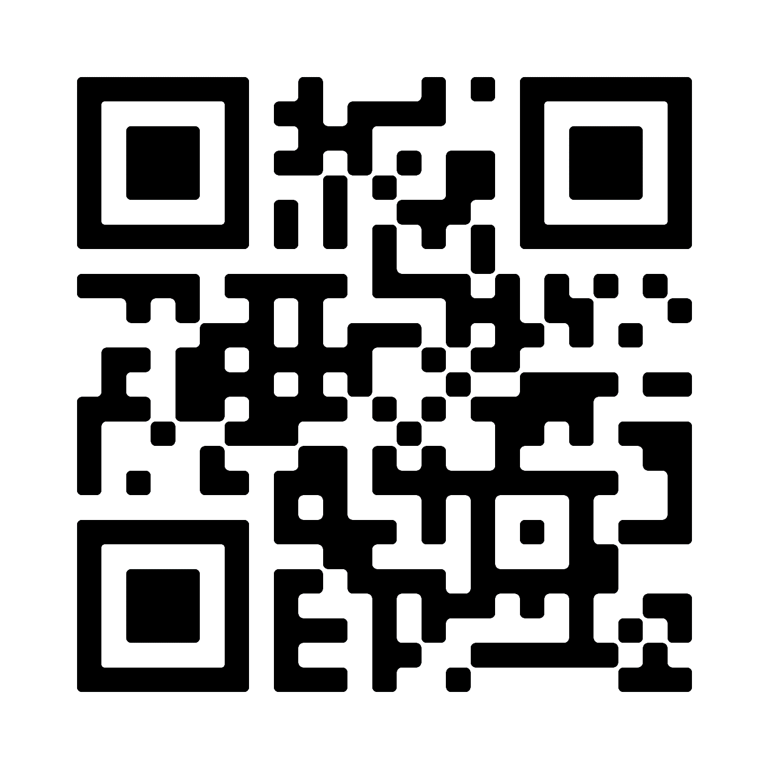
Support
Scout Fundraising
Trail’s End Support
Visit our FAQ page for answers to commonly asked questions & to open a ticket.
Council Support
Brian Domzalski
609-261-5850 x229
Brian.Domzalski@scouting.org
Trail’s-End Support Team
Support@trails-end.com
Facebook Group
Join Trail’s End Popcorn Community for best practices, support, news, and answers to questions.

Slide 25
THANK YOU!
Comments and Questions?
Notes:
Thank you again for carving time out of your busy schedules
You are all critical to the future of Scouting and we're honored to play a role in partnering with you to be helpful and supportive

